Slide 1
Medical Model Monitor
3M

Slide 2
CAPSTONE 5.4.4
Table of Contents
Problem, Proposed Solution
3M Solution
Use case
Pipeline
Sample: Patient HR Trends
Alerting
Deployment
Software lifecycle
Opportunities
Lessons Learned

Slide 3
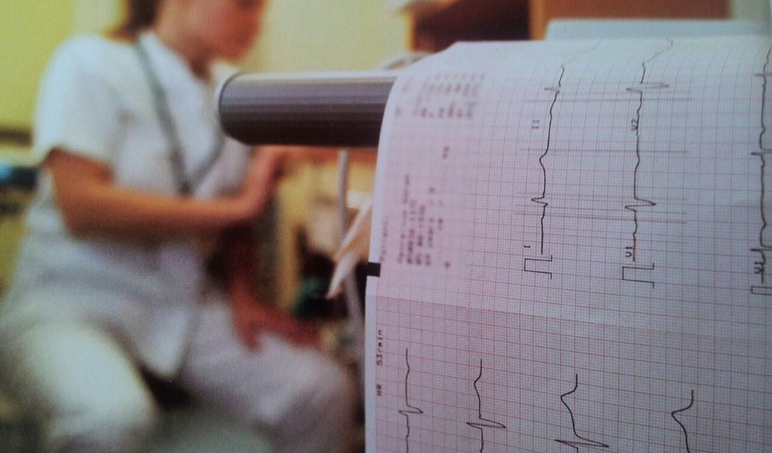
The problem in modern medicine.
Dated technology. Generic data. Manual overhead. Reactive.
Modern app feel. Tailored for staff and patients. Dynamic data. Proactive engagement.

Slide 4
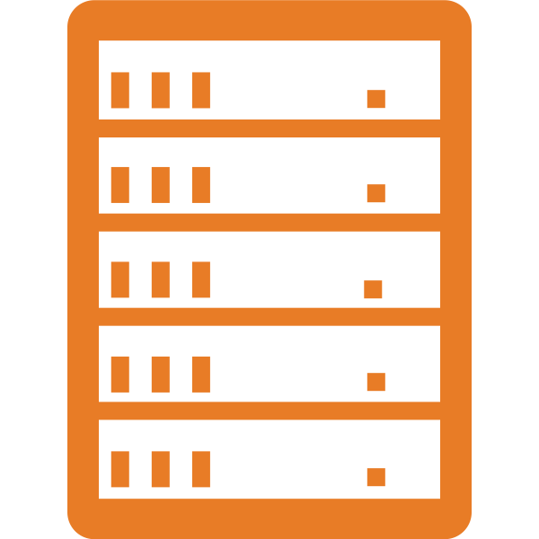

WHAT IS 3M
Analytics & Monitoring Suite
Proactive intervention to improve patient care.
Simplified architecture
Client-Server design
Scales quickly
Compliance friendly
Centralized data management
Access controls
Backup and recovery
Seamless Integration
Existing tools and data
No remote hardware installation
Custom Alerting
Tailored for each installation
Adjust conditions, thresholds, as needed
Facilitate success

Slide 5
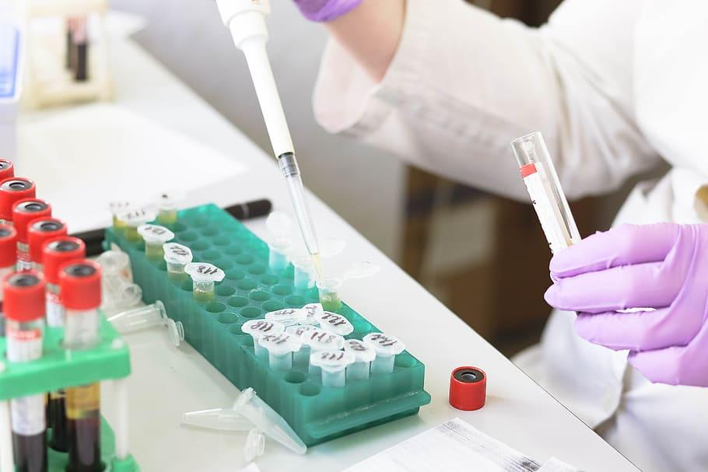

THE 3M DIFFERENCE
Universal knowledge
Improves with time and complexity
Continuous, 24/7/365
Inclusive design
No economic, demographic constraints
One instance provides for every patient
Conditional alerting
Customized for staff and facility needs
Proactive, trend analysis

Slide 6


THE 3M WORKFLOW
Collect
Train
Monitor
Act
Clinical, Research
Detect and classify needs
Monitors and Alerting
Review and Respond

Slide 7

3M
Heart Rate Analysis &
Patient Trending
Collect
Train
Monitor
Act

Slide 8
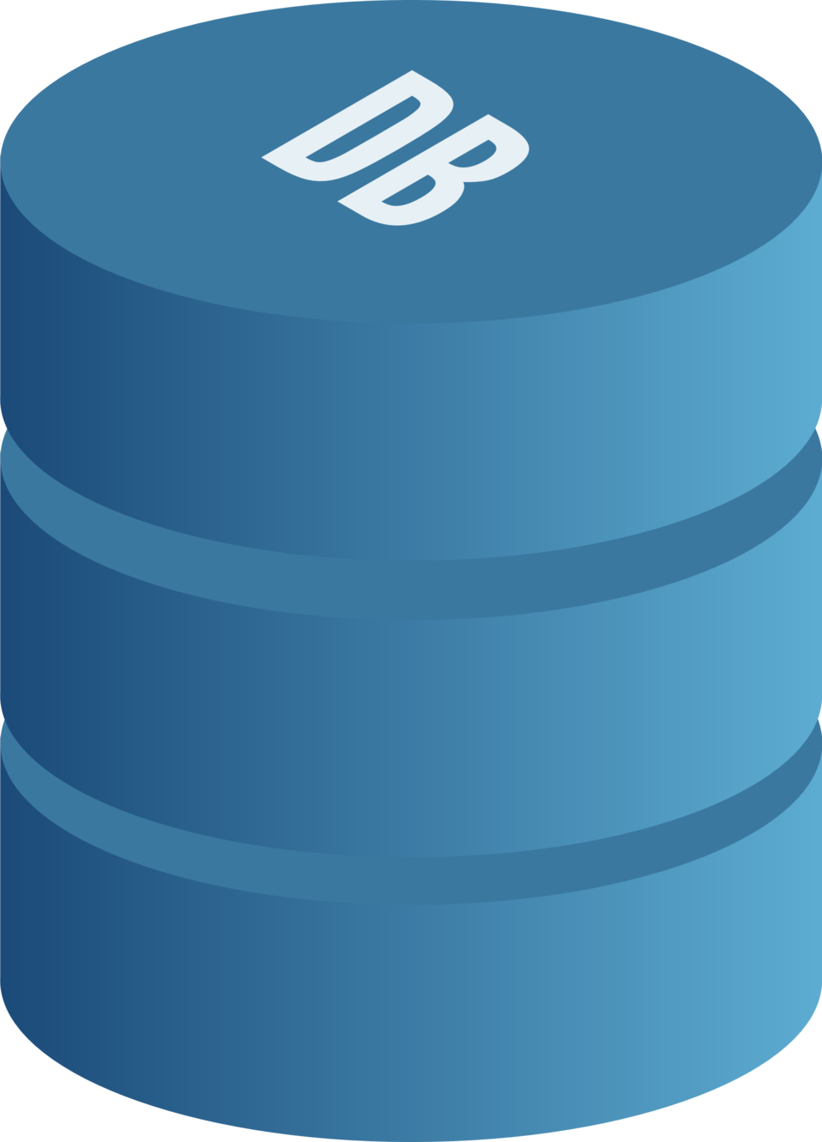


3M PIPELINE
Localized Data
Scope
Purpose
Quality
Model Training
Monitor: Client Software
MIMIC-IV
Act: Intervention
Collect
Train
Monitor
Act

Slide 9
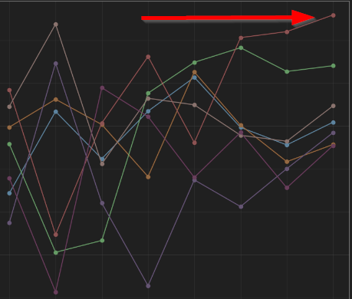
3M PIPELINE
Quality & Indicators
Efficiency: ~80%
Errors: Moderate
SpO2: Strong
Temperature: Weak
Performance Comparison
Retrain, or continue?
Collect
Train
Monitor
Act

Slide 10





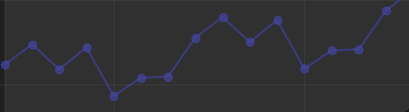

PATIENT PIPELINE
3M, MIMIC-IV
HR Forecast Snippet
Collect
Train
Monitor
Act

Slide 11
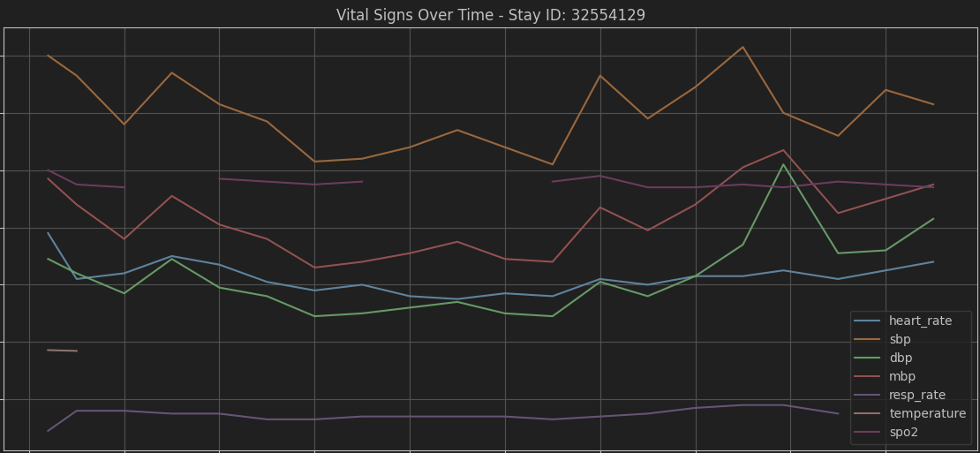

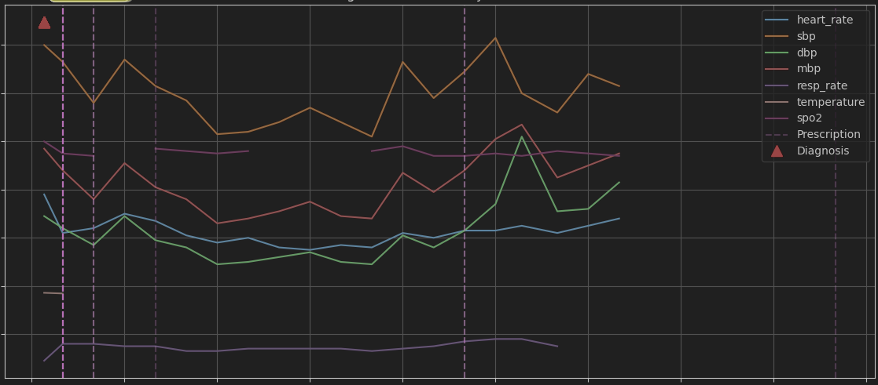
PATIENT PIPELINE
Basic analysis can identify issues before passing data to your models. This can help avoid lost time and wasted compute cycles ($).
Vitals
Data Point | Value
Visits | 2
Heart Rate | Nominal
Prescriptions | +10
Diagnosis | 1
+Rx, Diagnosis Events
Collect
Train
Monitor
Act

Slide 12
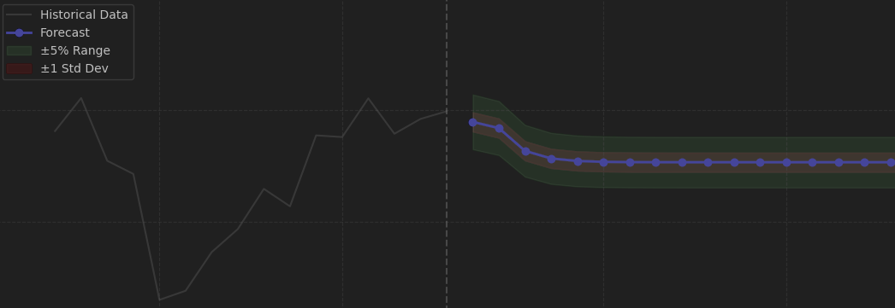
PATIENT PIPELINE (single)
(Left) Historical, (Right) Forecast + Variance
A perfect showcase!
Retrain, or continue?
Collect
Train
Monitor
Act

Slide 13
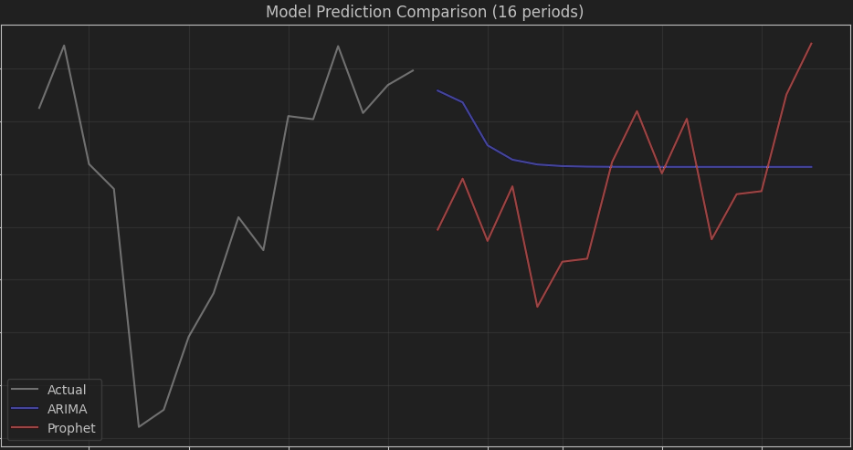
PATIENT PIPELINE (multi)
(Left) Historical, (Right) Forecasts
Similar training results…
Why such a visual discrepancy?
Collect
Train
Monitor
Act

Slide 14
PATIENT FORECAST ANALYSIS
Industry Knowledge
Healthy HR range
Within historical min/max
Root Cause
Data limitation!
Missed in raw form (#)
Next Steps
Confirm your findings!
Consider operating constraints
Agreements and expectations

Slide 15
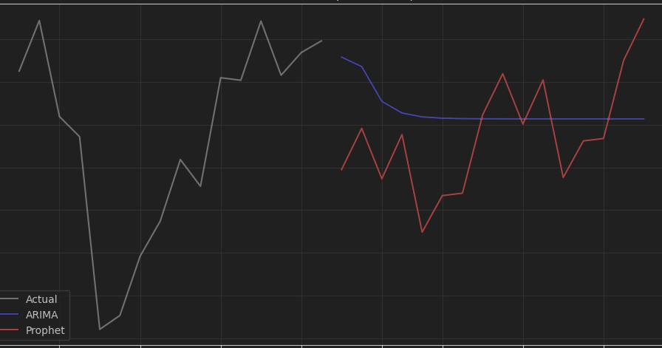
PATIENT PIPELINE: REAL-TIME
Stable Events
Within deviation, considered valid
Anomalous Events
Warn on degrading trends,
excess deviation…
Collect
Train
Monitor
Act

Slide 16

3M
Same benefits,
at any scale.
City ICU
Local
Clinic
Teladoc
Elder Care
Physical
Therapy
Relief
Effort

Slide 17



DEPLOYMENT MODEL
Local Clinic
Outpatient Svc
Family Practice
Software Connectivity
Intensive Care
In-patient Svc
Emergency

Slide 18
SUPPORT MODEL
Model Training
Train, deploy behind the scenes
Software Connectivity
In-patient Svc
Outpatient Svc
Data Enhancement
Research, Clinical Evidence…

Slide 19
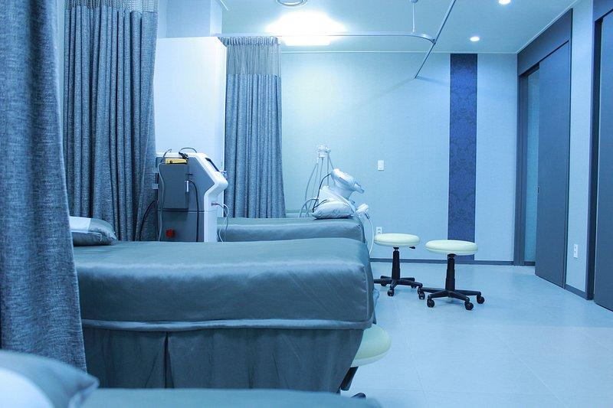
3M
Modern utilities, for modern medicine.
Familiar, intuitive experience.
One application, every patient.

Slide 20
CAPSTONE 5.4.4
Lessons Learned
Opportunities to Improve
Industry partners
Data access: controls
Data scale: sampling, dimensions
Compute: samples, full-scale
Interpreting results
Computing at scale
Pricing model
Expand features/dimensions
Supplement shortages
Neural network integration
Stronger pattern recognition
Highly flexible

